Slide 1
COTREM New Engine Planning and Review
Analysis of COTREM Model and discussion on ideas around plan of action for implementing the new Engine Model

Slide 2
Model Analysis
Model Classification
Templates Classification
Formula Classification
Project Context
Ideas on execution
New Engine Shortfalls/ Capabilities
Project Plan Design

Slide 3
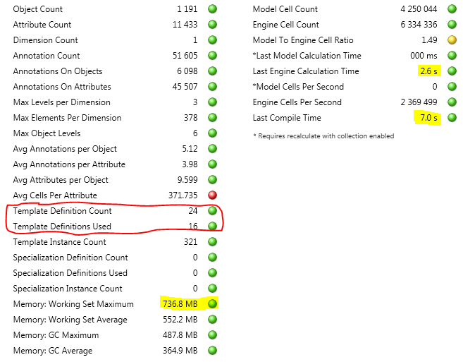
Model Analysis
Model Info for 1 year model

Slide 4
Model Analysis – Model Classification

Slide 5
Model Analysis – Template Distribution

Slide 6
Model Analysis – Formula Classification
It may be useful to classify the formula based on following criteria
Aggregation formula
Conditional formula (if statement)

Slide 7
Project Context
Customer | Anglo (COTREMS Model users)
Actors | Cyest Tech Engine Team(Richard and Jaisheel) + Cyest Tech Business Analyst(Cady)
Performance Measures | Engine Memory Foot print Engine Calculation Time Engine Compilation Time Accuracy/Consistency of the calculation
Environment | New engine plateform, template definitions in a Repository, c# engine
Transformation | Conversion of the current cotrems model engine to make use of the new engine
Owner | Cyest Technology (Dirk Kok)
World View | Proactive approach
Nature | Proof of Concept , Understanding of current flaws

Slide 8
Execution Ideas
Simplify calculations to be on only done on daily scale, ignore yearly and monthy scaling
Dumb down the Model to only contain single template type
Get the State data into the object tree without formula logic
Strategy needed for non template objects
Two step calculation Process
Document Conversion Process Per Model and per template definition
Compare Models Based on Values Export of New Engine vs Old Engine

Slide 9
New Engine Shortfalls and Capabilities
What is the formula language
Do we cater for Datasets
Can a formula stack set be set on the hierarchical dimension

Slide 10
Project Plan
Steps involved would include
Model Analysis
Template Definition Implementation
Shortfall formula design and development
Model Data load
Testing
Performance
Correctness
Performance Tweaking
Custom COTREM Calculation

